Slide 1

Cross site scripting (xss)
Lesson 9

Slide 2



3 Main Steps for XSS
FIND A REFLECTION POINT
BE ABLE TO INSERT JAVASCRIPT
DELIVER A PAYLOAD

Slide 3
Reflection point

Slide 4
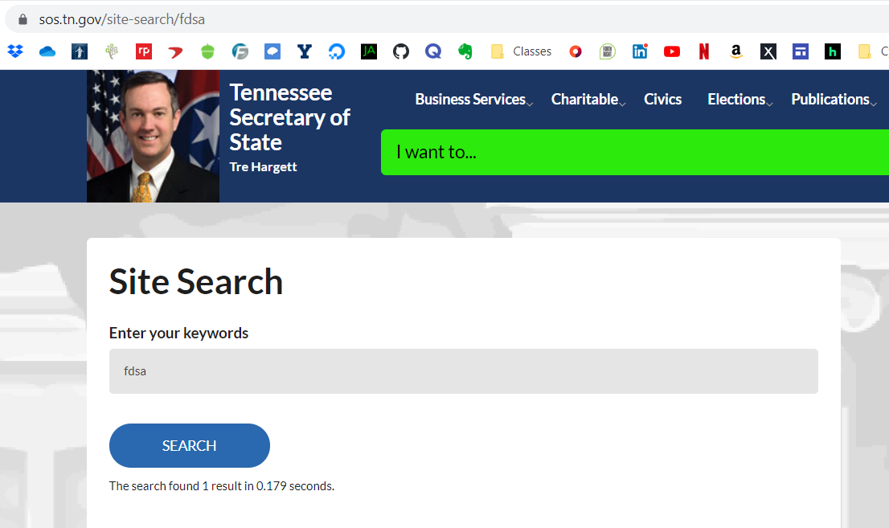


Reflection Point
A place on a website where user input is reflected
Comments
Bios
Social media and blog posts
Notes
Messages
What you type into the search bar
Two main types of XSS

Slide 5


Reflected XSS
User input is temporary
Custom URL
GET parameters
Form information
Search results
Possible but difficult

Slide 6
Stored/Persistent XSS
Malicious user input is stored in some sort of database or file
Each time someone visits a site, that stored input is displayed
Higher success rate because it doesn’t rely on tricking users into clicking links as much

Slide 7
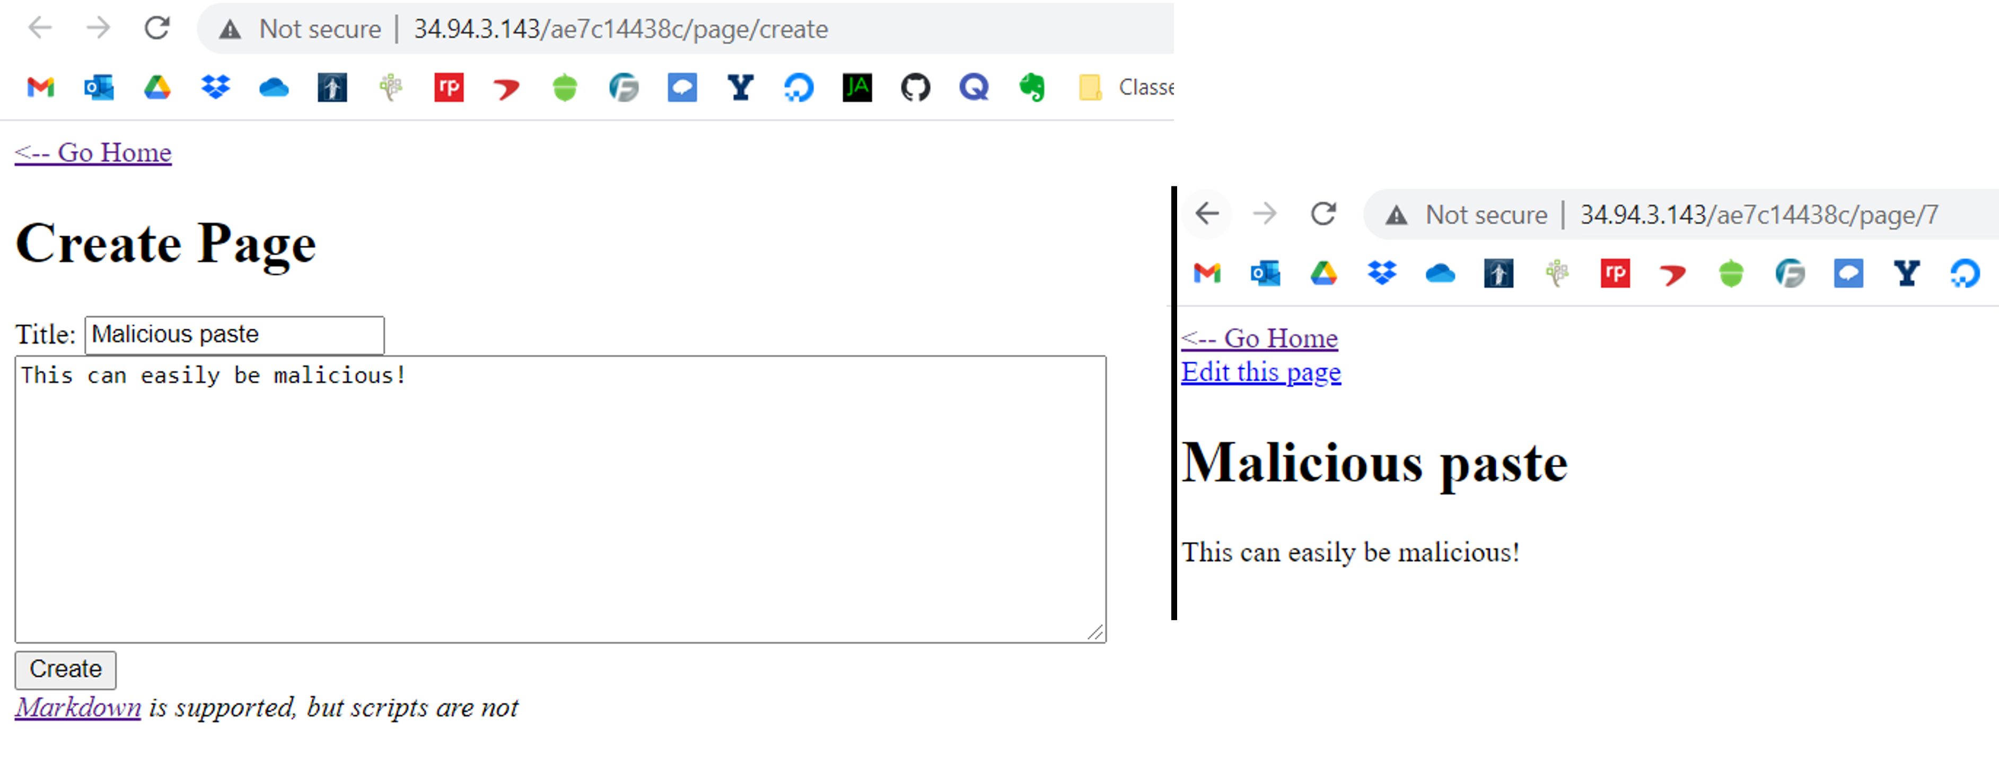

Slide 8
Insert JavaScript

Slide 9
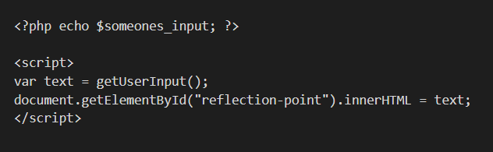
Example Source Code

Slide 10
JavaScript Syntax
textContent
Any tags will be treated as strings and will not turn into HTML
innerText
Any tags will be treated as strings and will not turn into HTML
However, if it’s the innerText of a script tag, it will turn into code that will be run
innerHTML
Any tags contained will be parsed as HTML entities
Any scripts will be run (only if this is when the page loads)
HTML5 states that “a <script> tag inserted with innerHTML should not execute.”

Slide 11
What should I insert?
Most common is <script> run_malicious_js(); </script>
Can also use attributes in HTML objects
Whatever is necessary to bypass XSS filters

Slide 12
Filtering
Replacing anything that says script with scrubbed (ineffective)
Inserting text with textContent or innerText (effective)
Using DOMPurify, an open-source library that filters out any XSS (effective)
Removing any <script> tags (ineffective)
Filtering out any single or double quotes (ineffective)
https://github.com/cure53/DOMPurify

Slide 13
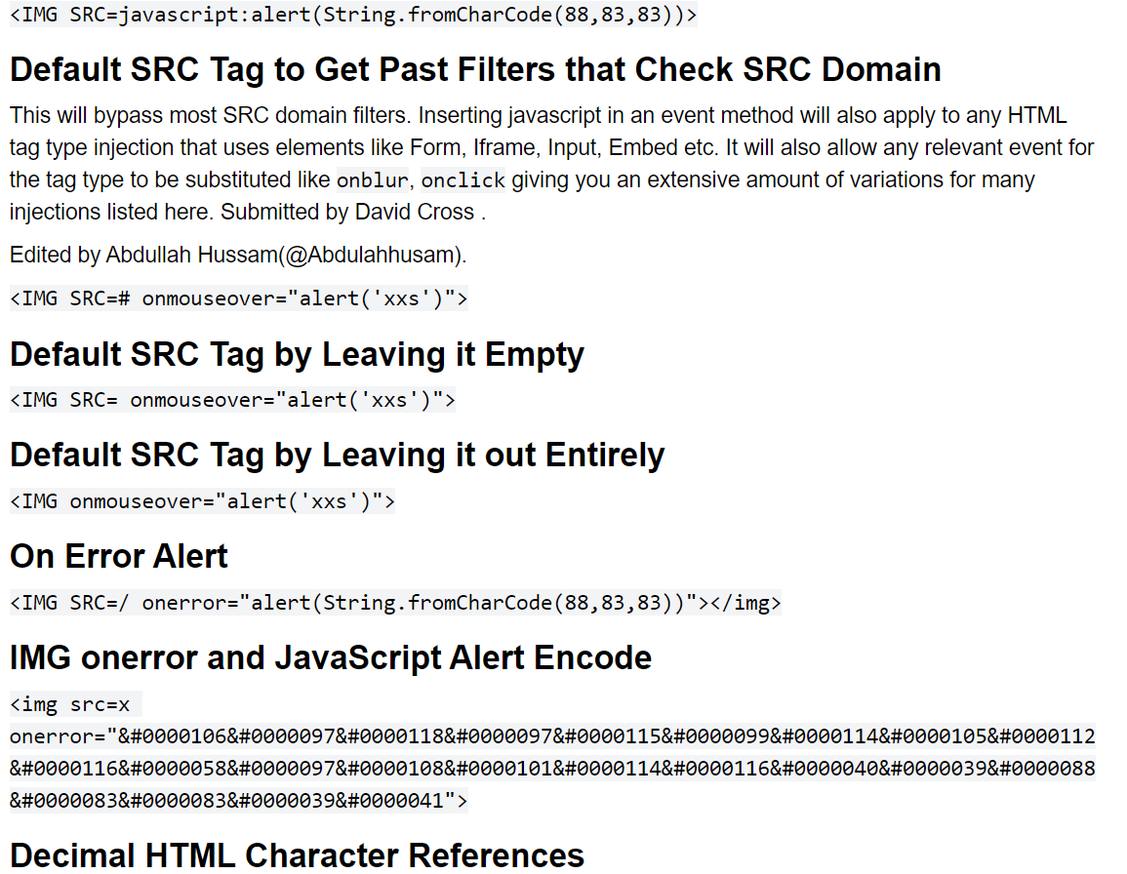
OWASP XSS Bypass Cheatsheet
https://owasp.org/www-community/xss-filter-evasion-cheatsheet

Slide 14
Payloads

Slide 15
What do you want?
Cookies (most common in CTFs)
Session IDs
Session credentials
Other sensitive information
Credentials being typed in
Contents of a webpage that only admin can visit

Slide 16
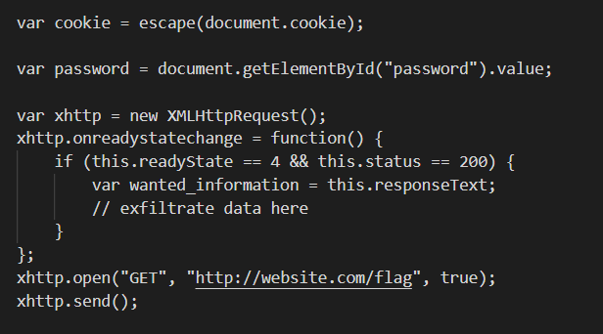
Example Payloads

Slide 17
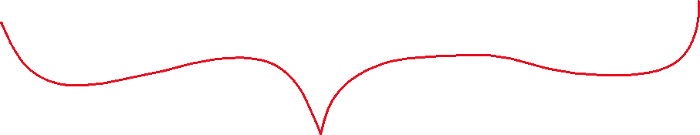
Exfiltration
Shows up in my website’s access logs

Slide 18
Payload Deployment
Phishing
XSS on another site
Meander onto site
Admin bot (CTF-only)

